Slide 1
TREES

Slide 2
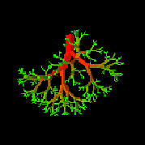
Tree View
root
leaves
branches
nodes

Slide 3
What is a Tree?
A tree is a finite nonempty set of elements.
It is an abstract model of a hierarchical structure.
Consists of nodes with a parent-child relation.
Applications:
Organization charts
File systems
Programming environments
Computers”R”Us
Sales
Manufacturing
R&D
US
International
Laptops
Desktops
Europe
Asia
Canada

Slide 4
A
subtree
B
C
D
E
F
G
H
I
J
K

Slide 5
Terminology
Root: node without parent (A)
Siblings: nodes share the same parent
Internal node: node with at least one child (A, B, C, F)
External node (leaf ): node without children (E, I, J, K, G, H, D)
Ancestors of a node: parent, grandparent, grand-grandparent, etc.
Descendant of a node: child, grandchild, grand-grandchild, etc.
Depth of a node: number of ancestors
Height of a tree: maximum depth of a node (3)
Degree of a node: the number of its children
Degree of a tree: the maximum number of its node.
Subtree: tree consisting of a node and its descendants

Slide 6
Example
A
Property
Number of nodes
Height
Root Node
Leaves
Interior nodes
Ancestors of H
Descendants of B
Siblings of E
Right subtree of A
Degree of this tree
Value
9
4
A
D,H,I,F,C
A,B,E,G
G,E,B,A
D,E,G,H,I,F
D,F
C
3
B
C
D
E
F
G
H
I

Slide 7
Tree ADT
We use positions to abstract nodes
Generic methods:
integer size()
boolean isEmpty()
objectIterator elements()
positionIterator positions()
Accessor methods:
position root()
position parent(p)
positionIterator children(p)
Query methods:
boolean isInternal(p)
boolean isExternal(p)
boolean isRoot(p)
Update methods:
swapElements(p, q)
object replaceElement(p, o)
Additional update methods may be defined by data structures implementing the Tree ADT

Slide 8
BINARY TREEs

Slide 9
Binary Trees
Applications:
Arithmetic expressions
Decision processes
Searching
A binary tree is a tree with the following properties:
Each internal node has at most two children (degree of two)
The children of a node are an ordered pair
(Position of left and right child matter)
We call the children of an internal node left child and right child
Alternative recursive definition: a binary tree is either
a tree consisting of a single node, OR
a tree whose root has an ordered pair of children, each of which is a binary tree
A
B
C
D
E
F
G
H
I

Slide 10
BinaryTree ADT
The BinaryTree ADT extends the Tree ADT, i.e., it inherits all the methods of the Tree ADT
Additional methods:
position leftChild(p)
position rightChild(p)
position sibling(p)
Update methods may be defined by data structures implementing the BinaryTree ADT

Slide 11
Examples of Binary Tree
Skewed Binary Tree
Complete Binary Tree
A
A
A
B
B
B
C
C
D
E
F
G
D
H
I
E

Slide 12
Tree vs Binary Tree
The subtrees of a binary tree are ordered; those of a tree are not ordered.
A
A
B
B
Are different when viewed as binary trees.
Are the same when viewed as trees.

Slide 13
Representation of a Binary Tree
A node is represented by an object storing
Element
Parent node
Left child node
Right child node
∅
B
∅
∅
B
A
D
A
D
∅
∅
∅
∅
C
E
C
E

Slide 14
Applications: Arithmetic Expression
Binary tree associated with an arithmetic expression
internal nodes: operators
external nodes: operands
Example: arithmetic expression tree for the expression (2 × (a - 1) + (3 × b))
+
×
×
2
−
3
b
a
1

Slide 15
Applications: Decision Tree
Binary tree associated with a decision process
internal nodes: questions with yes/no answer
external nodes: decisions
Example: dining decision
Want a fast meal?
Yes
No
How about coffee?
On expense account?
Yes
No
Yes
No
Starbucks
Subway
Plumeria
IHOP

Slide 16
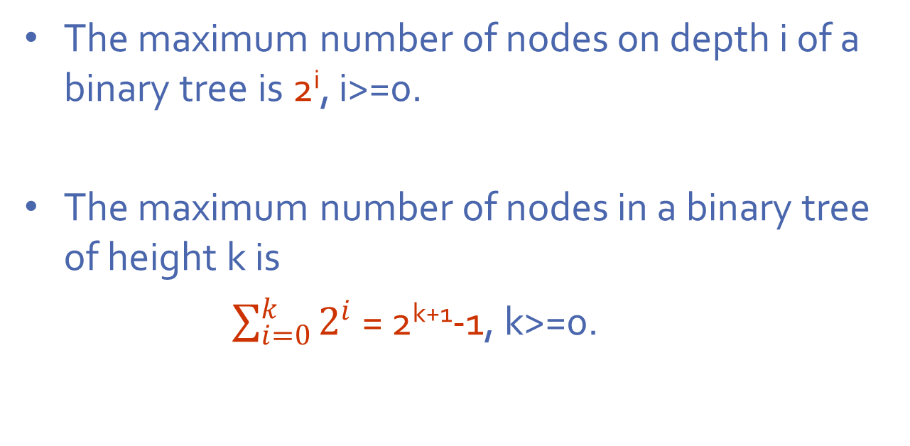
Number of nodes in a Binary Tree
The maximum number of nodes on depth i of a binary tree is 2^{i}, i>=0.
The maximum number of nodes in a binary tree of height k is
$\sum_{i=0}^{k}{2^{i}}$ = 2^{k+1}-1, k>=0.

Slide 17
Complete vs Full Binary Trees
A labeled binary tree containing the labels 1 to n with root 1, branches leading to nodes labeled 2 and 3, branches from these leading to 4, 5 and 6, 7, respectively, and so on.
A binary tree with n nodes and level k is complete iff its nodes correspond to the nodes numbered from 1 to n in the full binary tree of level k.
1
1
2
3
2
3
4
6
7
4
5
6
7
5
8
9
10
11
12
13
14
15
8
9
Complete binary tree
Full binary tree of depth 3

Slide 18
Binary Tree Traversal
Let l, R, and r stand for moving left, visiting the node and moving right.
There are six possible combinations of traversal
lRr, lrR, Rlr, Rrl, rRl, rlR
Adopt convention that we traverse left before right, only 3 traversals remain
lRr, lrR, Rlr
Inorder, Postorder, Preorder

Slide 19
The order in which the nodes are visited during a tree traversal can be easily determined by imagining there is a “flag” attached to each node, as follows:
preorder
inorder
postorder
To traverse the tree, collect the flags:
A
A
A
B
C
B
C
B
C
D
E
F
G
D
E
F
G
D
E
F
G
A B D E C F G
D B E A F C G
D E B F G C A
19

Slide 20
BINARY SEARCH TREES

Slide 21
Properties of a BST
Binary tree property
Each node has ≤ 2 children
Result:
storage is small
operations are simple
average depth is small
Search tree property
All keys in left subtree smaller than root’s key
All keys in right subtree larger than root’s key
Result:
Easy to find any given key
Insert/delete by changing links
8
5
11
2
6
10
12
4
7
9
14
13
Binary Search Tree does not allow duplicate values

Slide 22
Examples
8
5
More than 2 elements
15 is larger and on the left subtree
5
11
4
8
2
7
6
10
18
1
7
11
Left child is Larger
4
15
20
3
NOT A
BINARY SEARCH TREE
21
BINARY SEARCH TREE

Slide 23
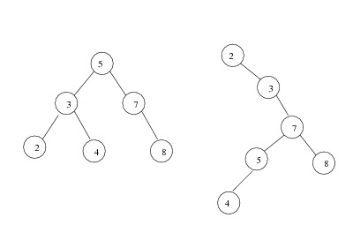
Multiple Trees for same set of Data
Average depth of a node is O(log N); maximum depth of a node is O(N)

Slide 24
Search - Recursive
10
find(Comparable key, Node<T> t)
{
if (t.key == key) return t;
else if (key < t.key && t.left!=null)
return find(key, t.left);
else if (key > t.key && t.right!=null)
return find(key, t.right);
else
return t;
}
5
15
2
9
20
7
17
30
Runtime:
Best-worse case? O(log n)
Worst-worse case? O(n)

Slide 25
Iterative Find
find(Comparable key, Node<T> t)
{
while (t != NULL && t.key != key)
{
if (key < t.key)
t = t.left;
else
t = t.right;
}
return t;
}
10
5
15
2
9
20
7
17
30

Slide 26
Finding Max & Min of a BST
Find minimum
Start from the root
Traverse left subtree recursively till you reach the left most leaf.
That is the minimum
Find maximum
Start from the root
Traverse the right subtree recursively till you reach the right most leaf.
That is the maximum
10
5
15
2
9
20
7
17
30

Slide 27
Insert in Binary Search Tree
Concept:
Proceed down tree as in Find
If new key not found, then insert a new node at last spot traversed
insert(Comparable x, Node<T> t)
{
if ( t == NULL ) {
t = new Node<T>(x);
} else if (x < t.key) {
insert( x, t.left );
} else if (x > t.key) {
insert( x, t.right );
}
}

Slide 28
Insert(25)
10
10
5
15
5
15
2
9
20
2
9
20
7
17
30
7
17
30
25

Slide 29
Delete in BST
Case 1: Node to be deleted is a leaf
Case 2: Node to be deleted has one child
Case 3: Node to be deleted has two children

Slide 30
Deletion - Leaf Case
Delete(17)
10
10
5
15
5
15
2
9
20
2
9
20
7
17
30
7
30

Slide 31
Deletion - One Child Case
Delete(15)
10
10
5
15
5
2
9
20
2
9
20
7
30
7
30
Notes:
Single child nodes we remove and…
Do what?
We can just pull up their children.
Is the search tree property intact?
Yes.

Slide 32
Deletion - Two Child Case
Delete(20)
Replace node with descendant whose value is guaranteed to be between left and right subtrees: the successor
Steps:
Start from the right child of the node to be deleted.
Traverse down find the left most leaf.
Replace the node to be deleted with the leaf.
10
5
15
2
9
20
7
17
30
11
25
40
Notes:
Ah, now the hard case.
How do we delete a two child node?
We remove it and replace it with what?
It has all these left and right children that need to be greater and less than the new value (respectively).
Is there any value that is guaranteed to be between the two subtrees?
Two of them: the successor and predecessor!
So, let’s just replace the node’s value with it’s successor and then delete the succ.

Slide 33

10
10
5
15
5
15
2
9
20
2
9
25
7
17
30
7
17
30
25
40
40

Slide 34
Binary Search Tree
Observations
Elements (even siblings) may be scattered in memory
Binary search trees are fast if they’re shallow
For large data sets, disk accesses dominate runtime
Some deep and some shallow BSTs exist for any data
Binary Search Trees are fast if they’re shallow:
Full
complete – possibly missing some “fringe” (leaves)
any other good cases?
Shorter branches
Notes:
OK, let’s think about BSTs in the same way we thought about heaps.
Indeed, some of the same ideas come up.

Slide 35
Time Complexities
Searching: worst case complexity of O(n). In general, time complexity is O(h) where h is height of BST.
Insertion: worst case complexity of O(n). In general, time complexity is O(h).
Deletion: worst case complexity of O(n). In general, time complexity is O(h).
Best case for all three is O(logn)

Slide 36
Dictionary (MAP) ADT

Slide 37
Dictionaries
A dictionary is a collection of elements each of which has a unique search key
Uniqueness criteria may be relaxed
Keep track of current members, with periodic insertions and deletions into the set
Examples
Membership in a club, course records
Language dictionary
Similar to database

Slide 38
Dictionary ADT
Simple container methods: size(), isEmpty(), elements()
Query methods: findElement(k) , findAllElements(k)
Update methods: insertItem(k, e), removeElement(k), removeAllElements(k)
Special element : NO_SUCH_KEY, returned by an unsuccessful search

Slide 39
Implementation of Dictionaries
Sequences / Arrays
ordered
unordered
Binary Search Trees
Skip lists
Hashtables

Slide 40

Using Unordered Arrays
Unordered array
Searching and Removing takes O(n) time
Inserting takes O(1) time
Application : Log files (frequent insertions, rare searches and removals)

Slide 41
Using Ordered Arrays
Searching takes O(log n) time (binary search)
Inserting and Removing takes O(n) time
Not logn because even if the item can be found in log n time, array elements need to shifted down or up (arrays are static memory not linked)
Application : Look-up tables (frequent searches, rare insertions and removals)

Slide 42
Using Binary Search Trees
Implement a dictionary with a BST
Each internal node stores an item (k, e) of a dictionary.
Keys stored at nodes in the left subtree of v are less than or equal to k.
Keys stored at nodes in the right subtree of v are greater than or equal to k.

